Slide 1
SPM PRESENTATION
G6

Slide 2
Team's
Progress

Slide 3

Sleep
Eat
Code
Repeat!
Iteration 2 Emphasis:
Code Projects Functionalities

Slide 4


Iteration 1
Login
Student Only
Admin yet to implement
Add Bids
Bid for a section
No restrictions
Bootstrap
No Validation.

Slide 5
Iteration 2
Login
Admin & Student
Add Bids
Restriction coded or tweaking may be required
Test Cases and Bug Metrics (Critical)
5 Sections only
Balance e$ upon success
Clash of exam & class
1 Section per Course
Bidding round restrictions
Insufficient e$
Pre-requisite courses
Drop Bids
Implemented but tweaking may be required
Test Cases and Bug Metrics (Critical)
Drop Sections
Static

Slide 6
Iteration 2 (cont.)
Bootstrap
Validation implemented
Test Cases and Bug Metrics (Critical)
Bootstrap output
JSON
Student and Admin output
Others yet to be implemented: e.g. JSON Checker
Rounds
Rounds is active
Round Cleaning logic

Slide 7
Functionalities
Do you plan to drop/add any functionalities?
Not dropping any functionalities
Adding quality of life improvements:
An additional warning pop-up during dropping of a section to remind the student of the refundable e-cash.
Able to filter courses by Date, Time, Course ID, and instructor
Able to view sections of successful bids on landing page
Do you plan to use any PHP frameworks?
No, planning to use PHP frameworks but bootstrap 4

Slide 8
SPMisgreat!
IP Address: 18.216.225.229
Is the admin password for our cloud deployment

Slide 9
Schedule

Slide 10
Schedule
Week 3:
Team meeting to discuss job scope, project requirements
Brainstorming UI and site mapping
Trello and Google sheets
Week 4:
Assignment of Pair Programmes
Review of wireframe designs and comparison against functional document (Wiki)

Slide 11
Schedule
Week 5:
Wireframe updates
Begin coding
DAO and Bootstrap
Basic pages (Login admin page)
Code unaffected pages:
“User bid and pending” page
“Add bids” page
Week 6:
Preparation for PM review
Determining the project requirements
Updating of wireframes for recently discovered functional cases
Preparing PM Review slides and content
Consolidating and reviewing current operational pages of the project presentation

Slide 12
Schedule
Week 7, (Iteration 2) :
Discuss feedback for PM review
JSON APIs.
Next round of coding
Update of database with new table
Login for admin page
Week 8 (Recess Week):
code following function
Bootstrap Validation
JSON API bootstrap output
Initiate Rounds
Drop bids
Add bids validations

Slide 13
Schedule
Week 9
Update PM online review slides and content
Regression testing, Test Cases & Bug Metrics (Pre-review)
Week 8 Code Function
Discuss feedback or questions of the online review (After 17 Oct)
Code following function
Round(s) clearing Logics
Bids converts to sections
JSON checker
Regression testing, Test Cases & Bug Metrics (Post review)

Slide 14
Schedule
Week 10 (Bug fixes and functionality checks):
Regression testing, Test Cases & Bug Metrics, acquire test case from other teams
Code functions from week 9 (continue)
Review all functions
Ensure each page is functional in relation to the other

Slide 15
Schedule
Week 11 (Iteration 4, UAT):
Preparation of UAT
Regression testing
Time allocated for fixes
Consolidation of any logistics required (Laptop, Ethernet Cable... etc.)
Push and test any new functionalities and release to UAT
Review outcome from UAT
Week 12:
Implement fixes
Implement fixes from UAT results
Week 13:
Implement fixes
Implement fixes from UAT results
Prepare for final presentations

Slide 16
Schedule
Week 14:
Prepare for final presentations
Final Presentation

Slide 17
Iteration Schedule
Iteration # | Date
1 | 19th September - 3rd October
2 | 4th October - 17th October
3 | 18th October - 31st October
4 | 1st November - 14th November
5 | 15th November - 21st November

Slide 18
Project Milestones
Iteration # | Milestones
1 | Initialize Project
2 | PM Review
3 | Application Demo
4 | UAT
5 | Final Presentation

Slide 19
Iteration breakdown
Iteration # | Details
1 | Administrative work: Understanding the scope of the project Scheduling Understanding the structure of our product Looking at wireframes and how they link Update according to recent discussions

Slide 20
Iteration breakdown (cont.)
Iteration # | Details
1 | Unplanned changes in functionality Update of design Initialise Coding Database and Bootstrap and simple pages
2 | PM Review (Start iter 2) Administrative work: Mid project review Code Overall functionality Regression testing regression testing & bug test and fixes Preparation for Application Demo

Slide 21
Iteration breakdown (cont.)
Iteration # | Details
3 | Application Demo (Start iter 3) Progress Update Consolidation of pages Code remaining functionalities Regression testing & bug test and fixes
4 | UAT Preparation (Start iter 4) Implement fixes (If required) Preparation of Final Presentation
5 | Final Presentation

Slide 22
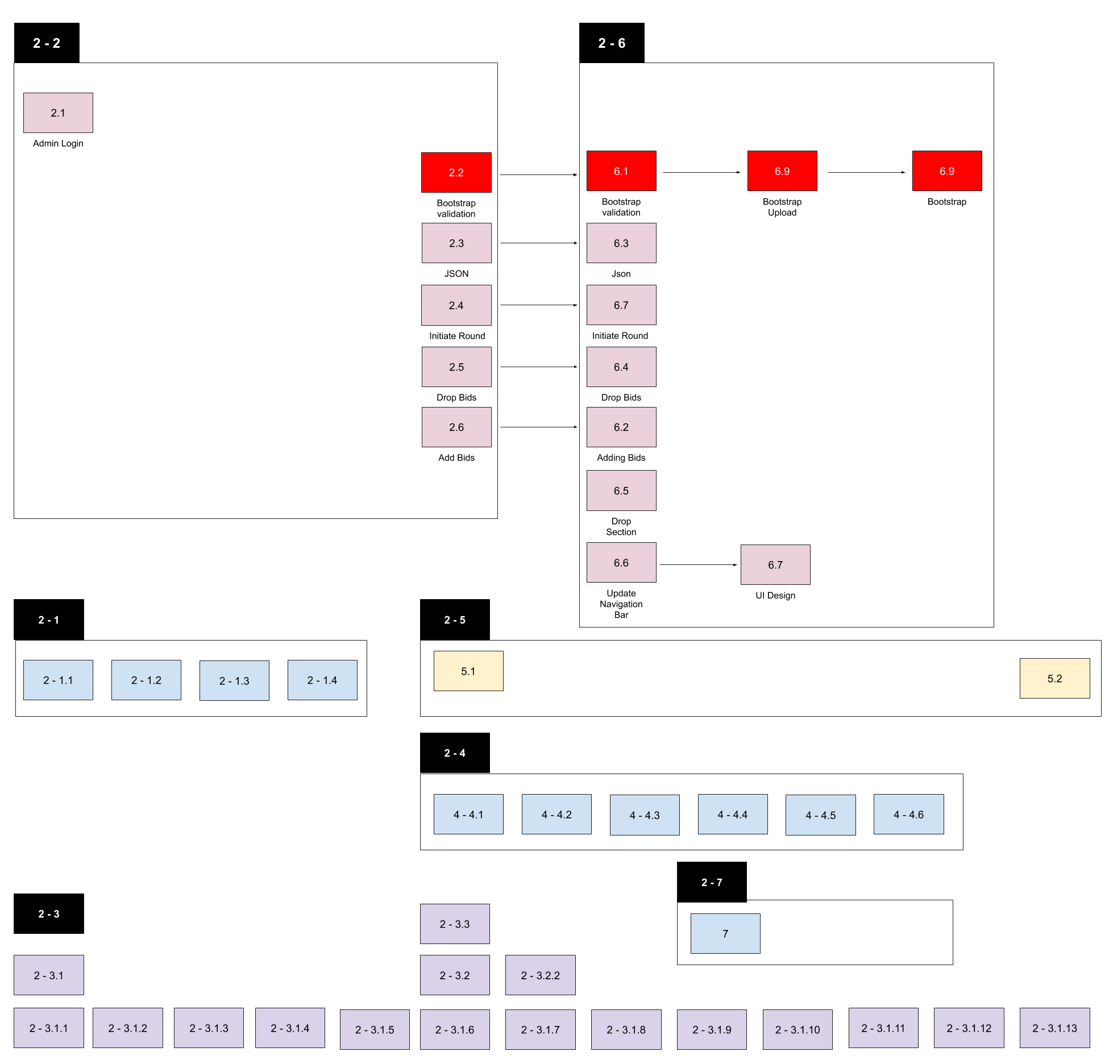
Iteration 2

Slide 23
Testcase &
Bug Metric

Slide 24


Test Cases & Bug Metrics
Login
Bootstrap Upload

Slide 25
Roles and Responsibilities

Slide 26
Roles and Responsibilities
Iteration | Week | Project Manager
1 | Week 5 to Week 7 | Matthew
2 | Week 7 to Week 9 | Vittorio
3 | Week 9 to Week 11 | Da Eun
4 | Week 11 to Week 13 | Brendon
5 | Week 14 | Sheng Qin

Slide 27
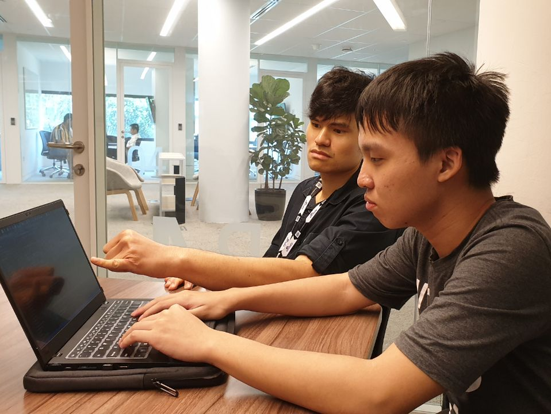
Place your screenshot here
Pair
Programming

Slide 28
Pair Programming Rotation
Iteration | Week | Project Manager | Programming pairs |  | Date
1 | Week 5 to Week 7 | Matthew | Sheng Qin and Vittorio | Brendon and DaEun | 19 Sep - 3rd Oct
2 | Week 7 to Week 9 | Vittorio | Matthew and Brendon | Sheng Qin and DaEun | 4 Oct- 17th Oct
3 | Week 9 to Week 11 | Da Eun | Sheng Qin and Brendon | Vittorio and Matthew | 18 Oct - 31 Oct
4 | Week 11 to Week 13 | Brendon | Matthew and DaEun | Sheng Qin and Vittorio | 1 Nov - 14 Nov
5 | Week 14 | Sheng Qin | Da Eun and Brendon | Matthew and Vittorio | 15 Nov - 21th Nov

Slide 29
Pair Programming Tasks
Task | Members involved | Start time | End time
Code DAO for the various tables | DaEun, Brendon | 9/9/2019 12:00 | 9/9/2019 13:00
Code user/admin login page without bootstrap, but with reference to an imported database with sample data | DaEun, Brendon | 9/9/2019 13:00 | 9/9/2019 13:45
Create Database | DaEun, Brendon | 9/9/2019 13:45 | 9/9/2019 15:00
Code user bid and pending page in accordance with hard-coded information | Sheng Qin, Vittorio | 10/9/2019 10:00 | 10/9/2019 13:00

Slide 30
Special thanks to all the people who made and released these awesome resources for free:
Presentation template by SlidesCarnival
Photographs by Unsplash

Slide 31
Thank you!

